Slide 1


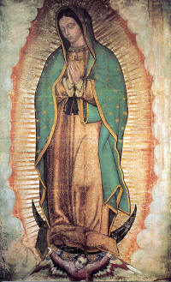
Daily Practices of the Mission

Slide 2

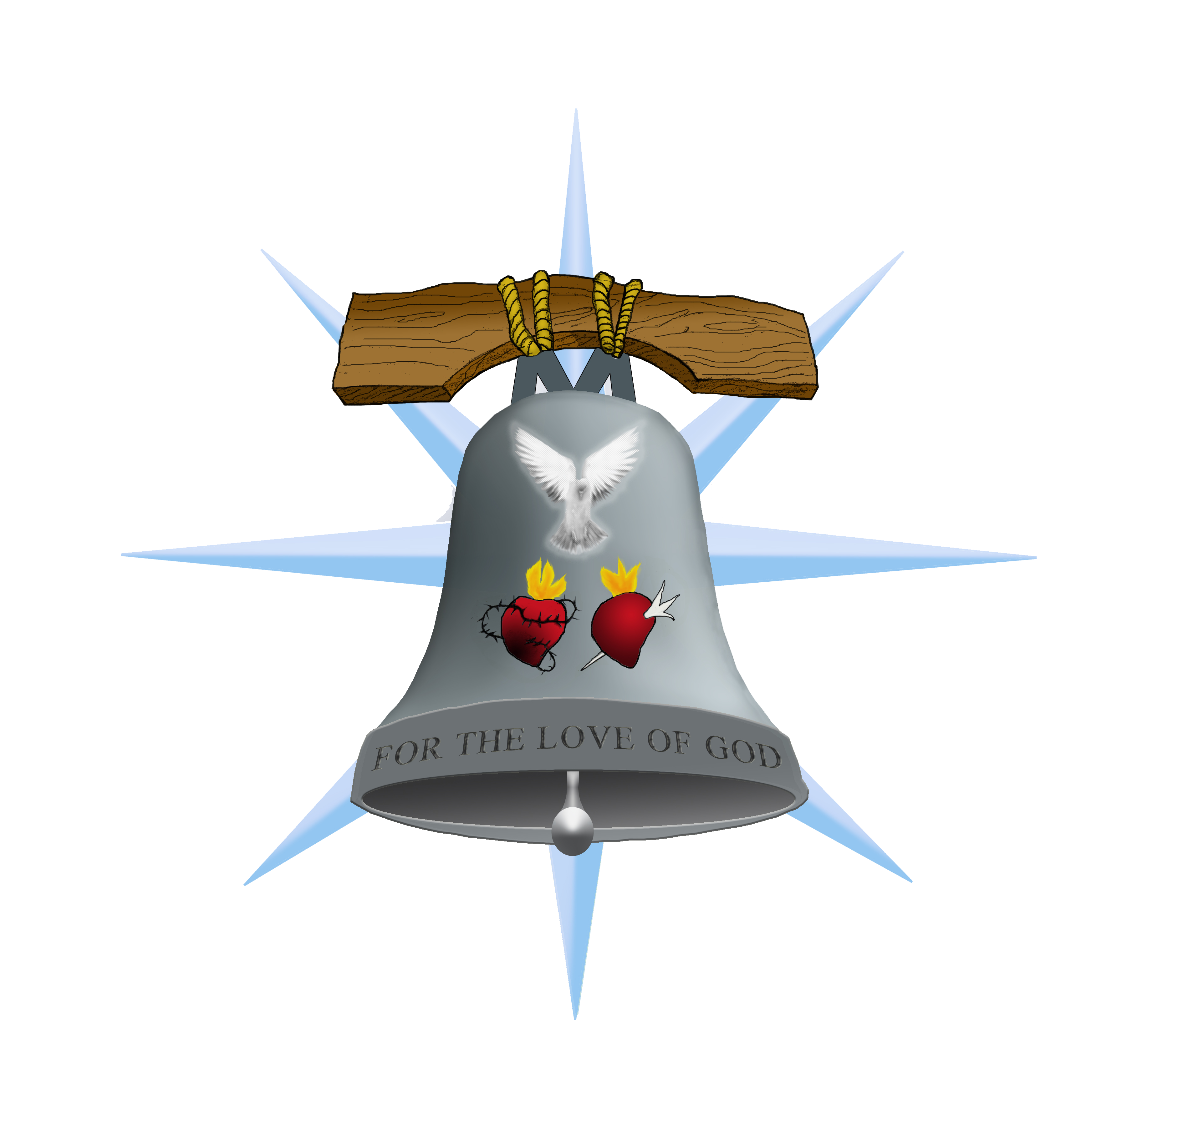
The Daily Spiritual Guidelines Suggested by the Mission
Found in pages 48-49 of the Missions Manual
A suggested approach to prayer, utilizing the sacraments and other helpful elements in the tradition.
The guidelines are offered to foster a living relationship with God.

Slide 3

Clarifications about Prayer

Slide 4
What Prayer is Not
Manipulation of God to get what we want
It is not making God Love us
It is not appeasing God
Get out of jail free card
We do not honor him by the heaping up of prayer
The fundamental prayer, the fundamental sacrifice according to psalm 50 is a heart open to God.
“For you take no delight in sacrifice; were I to give a burnt offering, you would not be pleased. The sacrifice acceptable to God is a broken spirit; a broken and contrite heart, O God you will not despise.” RSV Ps 50:16,17

Slide 5
“For you take no delight in sacrifice; were I to give a burnt offering, you would not be pleased. The sacrifice acceptable to God is a broken spirit; a broken and contrite heart, O God you will not despise.” RSV Ps 50:16,17
We do not Honor him by heaping up more sacrifices.
The fundamental prayer, the fundamental sacrifice according to psalm 50 is a heart open to God.
Growth in prayer leads from a relationship with God, not with doing more things

Slide 6
What Prayer Is
Prayer is the raising of one’s mind and heart to God or the requesting of good things from God CCC 2559
Intimate Relationship
  When you pray, go into your room and shut the door and pray to your Father…”Our Father who art in heaven.” (RSV Mt6:6,9)
More than Words
  “and in praying do not heap up empty phrases as the Gentiles do; for they think that they will be heard for their many words.” (RSV MT 6:7)

Slide 7
Explanation of Prayers in the Suggested Daily Spiritual Guidelines

Slide 8
Prayers of Offering
Rejoice always pray constantly, give thanks in all circumstances; for this is the will of God in Christ Jesus for you. (RSV 1Thessalonians 5:16-18)
Morning Prayer of the Mission
Offer what you are doing until it becomes a habit of prayer
  Offer work each day as a prayer for the conversion of sinners.
Pray for the gift of daily Mass
Prayers of Offering invites God to draw us to himself.
  God perfects our work and the desires of our hearts

Slide 9
Sacraments

Slide 10
Eucharist
The Eucharist is "the source and summit of the Christian life” (LG11). "The other sacraments, and indeed all ecclesiastical ministries and works of the apostolate, are bound up with the Eucharist and are oriented toward it. For in the blessed Eucharist is contained the whole spiritual good of the Church, namely Christ himself, our Pasch.” (PO 5)
-Catechism of the Catholic Church 1324
The Eucharist is centrally important to Christian life.
The Eucharist has pride of place amount the Daily Guidelines.
We need the Eucharist to strengthen the work that we do so that it becomes a pleasing sacrifice.

Slide 11
Eucharistic Adoration
Mane Nobiscum Domine
  “Stay with us Lord” (Luke 24:29 )
In the Eucharist Adoration we marvel at God’s fulfillment of our need, like that of the disciples on the way to Emmaus.
We share with Jesus our understanding of himself and he teaches us.
Adoration (as often as possible) but as a minimum once a week.
  30 Minutes for the Rosary
  30 Minutes of Silent Prayer
The Rosary to consider God’s gift to us.
Silence in order to listen to the Lord speaking to us.
Silent prayer in Adoration is dialogue with God.

Slide 12
Confession
Christ is at work in each of the sacraments. He personally addresses every sinner: “my son your sins are forgiven.” He is the physician tending each one of the sick who need him to cure them. He raises them up and reintegrates them into fraternal communion. Personal confession is thus the form most expressive of reconciliation with God and with the Church. CCC 1484
Confession is medicine for the soul.
  Leads towards growth.
  Jesus helps us to leave different, even if it is only a little different.
  Leads us back to the food of the Eucharist
Confession is about Jesus leading us in a positive direction rather than learning how terrible we are.

Slide 13
Devotional Prayer

Slide 14
Devotional Prayer
Devotion
  From Latin word meaning “to dedicate formally, to consecrate
  There is a certain commitment inspired
  Commitment is inspired from the heart.
Devotions are also a connection with the heart to God
  Draws us into deeper relationship
  Attains a perfection of the soul
  Attains a death to self
  Without these fruits there is danger of false devotion

Slide 15
The Rosary
Meditation on Jesus’ life in the gospels.
Connects us to the safe refuge of the Immaculate Heart of Mary
Hail Mary’s are repetitive but they are also
  a repetition of the Incarnation
  Mary’s yes against the enemy’s no
Fruits of the True Devotion of the Rosary:
  Death to self
  Perfection of Soul
  Contemplation

Slide 16
Suggestions about the Rosary
Start Small
  Daily Rosary
  Sorrowful mysteries
Work up to 3 mysteries of the Rosary
  Always in accord with ones state in life (Priest, lay, married)
  It helps to pray as a family
  It helps to invite friends to join you in the commitment to pray the rosary.
Remember that 20 minutes of praying the rosary is more restful to our spirit than 30 minutes of watching television. Our soul NEEDS prayer to breath.

Slide 17
The Stations of the Cross
Walking with Jesus the road to Calvary
Consideration of the depths of Jesus’ love
  In the midst of his agony he loves us
  Jesus does not regret his suffering
  In considering his love we receive it as a grace
It is a devotion entering into the mystery of Jesus’ passion.

Slide 18
St. Bridget Prayers
15 Prayers of St. Bridget honor the wounds of Jesus
  Bridget wanted to know each of wounds of Jesus to honor them.
  After a long time Jesus revealed he received 5,480 wounds.
  The 15 prayers said each day for a year honors the each of the wounds of Jesus.
As a Devotion we pray the St. Bridget prayers in order to more deeply appreciate and honor the wounds of Jesus.
Notes:
The prayers of St. Bridget are in devotion to the wounds of Christ. As we have received the tradition St. Bridget in devotion to the wounds of Jesus besought him to reveal to her the number of blows he received. The prayers of St. Bridget then are an opportunity for one to grow in devotion to the Holy Wounds of Jesus.

Slide 19
Prayer for the Holy Souls
Act of Charity
Helps the Holy Souls get to heaven
The Holy Souls help us
  God always rewards charity
  Souls are grateful and pray for us
“Oh! If it were but known how great is the power of the good souls in purgatory with the Heart of God, and if we knew all the graces we can obtain through their intercession, they would not be so much forgotten. We must, therefore, pray much for them, that they may pray much for us.” – St. John Vianney
We may piously believe that God makes our prayers known to them; and then they, full of charity as they are, most assuredly do not omit to pray for us.” St. Alphonsus Ligouri – The Great Means of Salvation and of Perfection

Slide 20
Living out our Conversion

Slide 21
Attitudes for Living out Conversion
Attitudes for living out conversion is the choices we make to to say no to evil and say yes to God.
  Daily turning to God
  Asking for his help with
    Ourselves
    Our Families
    Our World
“The word is very near you; it is in your mouth and in your heart, so that you can do it…I have set before you life and death, blessing and curse; therefore choose life, that you and your descendants may live.”
-Dt 30:14,19

Slide 22
Attitudes for Living out Conversion
We Commit to
  Stop offending God
  Cease remaining silent before evil
Change begins with “me”
Pray for Things which need changing
  In Society
  In Government
  In our Home
Pray for
  Leaders
  Spouses, children
  Holy Souls, the poor, the sick, the elderly

Slide 23
Fasting
I asked your disciples to cast it out, and they were not able…Why could we not cast it out? And he said to them, “This kind cannot be driven out by anything but prayer and fasting.”
Mark 9:18b, 18b, 29
There are kinds difficulties we face that are more difficult than others.
The gospel indicates that prayer united with fasting is required to drive out these types of evil.
Prayer united with fasting is powerful, but why?

Slide 24
Fasting
I asked your disciples to cast it out, and they were not able…Why could we not cast it out? And he said to them, “This kind cannot be driven out by anything but prayer and fasting.”
Mark 9:18b, 18b, 29
NOT about power or gaining hidden strength.
Fasting changes something in us that facilitates God’s work.
Voluntary sharing in the suffering of Christ, himself and in others
Helps grow in abandonment to God’s will
Trust in God not in self

Slide 25
Review
Prayer is Work
  We have to work at praying well.
  Start praying and let God teach you.
Effective prayer flows from a living relationship with God
Devotions do not automatically provide but foster a growing relationship with God
Deepening prayer life always has a relationship to the sacraments.
Start gradually trusting in God to bring the growth.
Therefore, since we are surrounded by so great a cloud of witnesses…let us run with perseverance …looking to Jesus the pioneer and perfector of our faith” Hebrews 12:1-2

Slide 26
Summary of the Suggested Guidelines
The Morning Prayer of the Mission
Offer work as a prayer
Pray for gift daily mass
Daily Rosary
Adoration (weekly)
Confession
Fasting twice a week
St. Bridget Prayers
Stations of the Cross
Commit to Personal Change
Pray for society/change in society
Pray for souls in Purgatory
Pray for the Church and for sinners
Pray for the poor, sick and the elderly.
Pray to Love God with all Heart, all your soul, and all your mind, then, pray to love one another

Slide 27
Suggested Works for learning to pray
The Secret of the Rosary, St. Louis de Montfort
Introduction to the Devout Life, St. Francis de Sales
El Secreto del Rosario, San Luis María de Montfort
Introducción a la Vida Devota, San Francisco de Sales

